Slide 1


College of Science Strategic Financial Report
Vrushali Bokil, Interim Dean of Science
Mark Johnson, Interim Financial Planning Manager

Slide 2
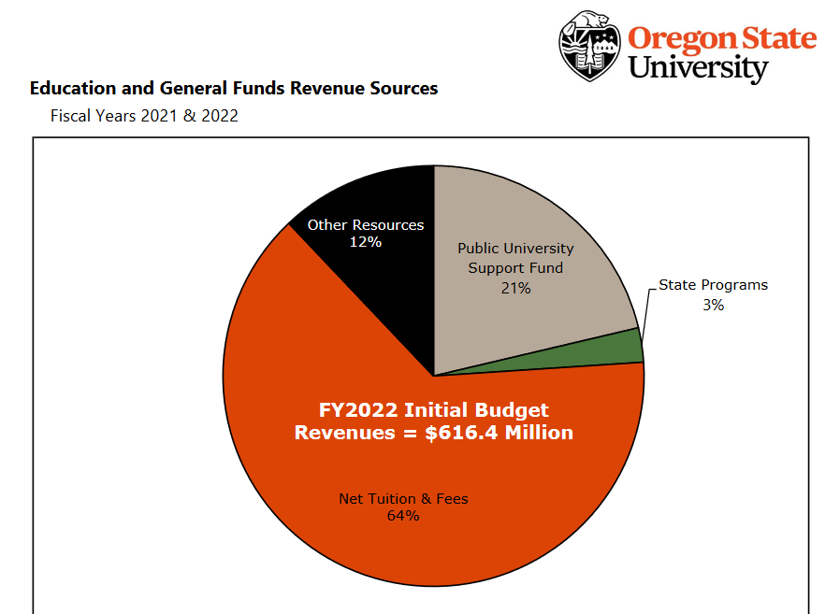

Slide 3
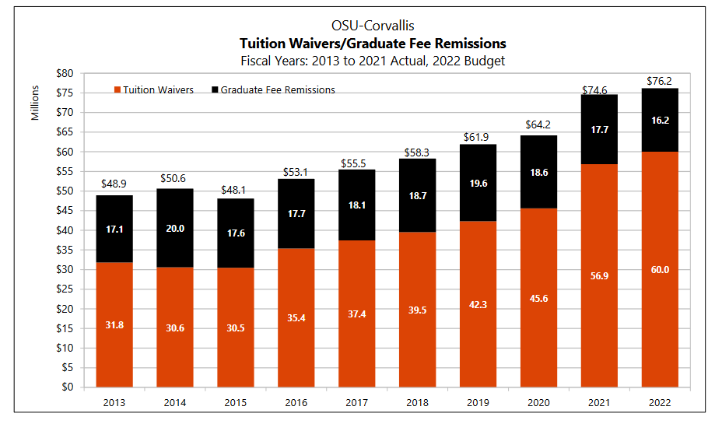

Slide 4
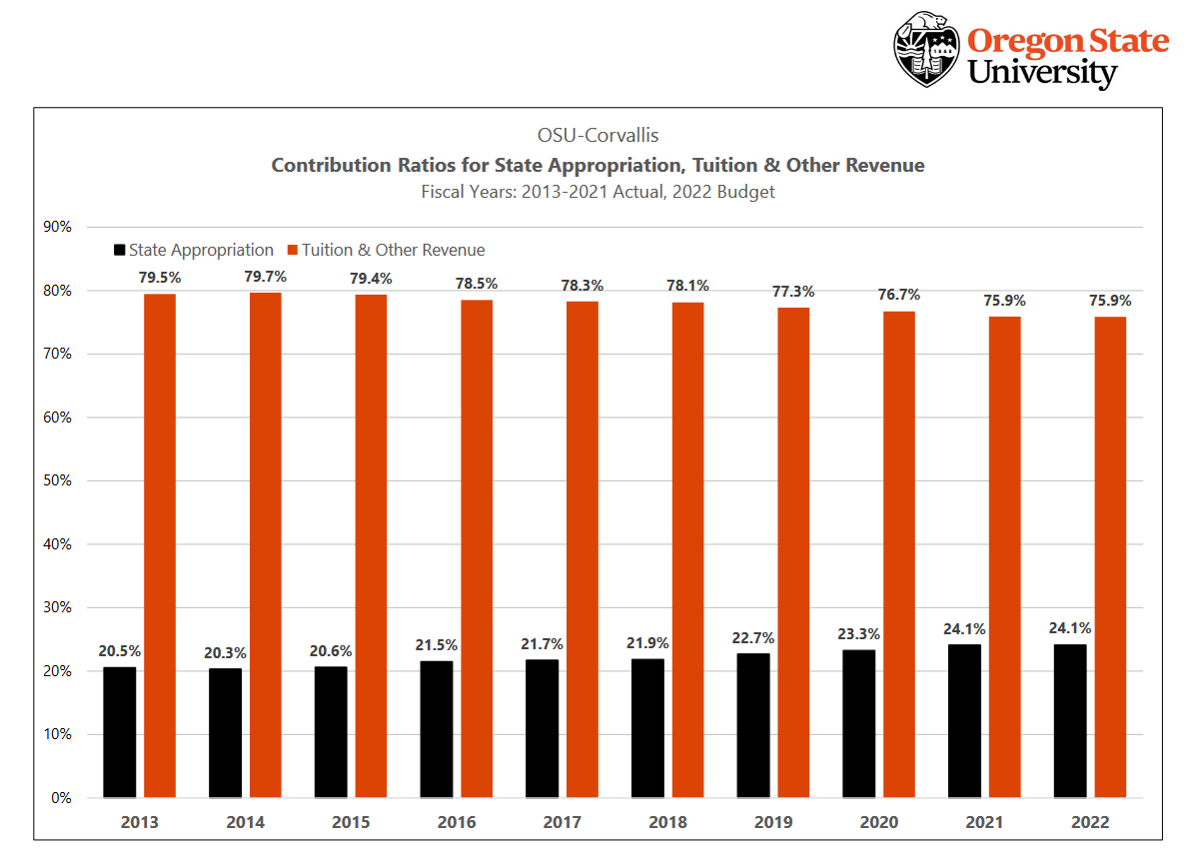

Slide 5
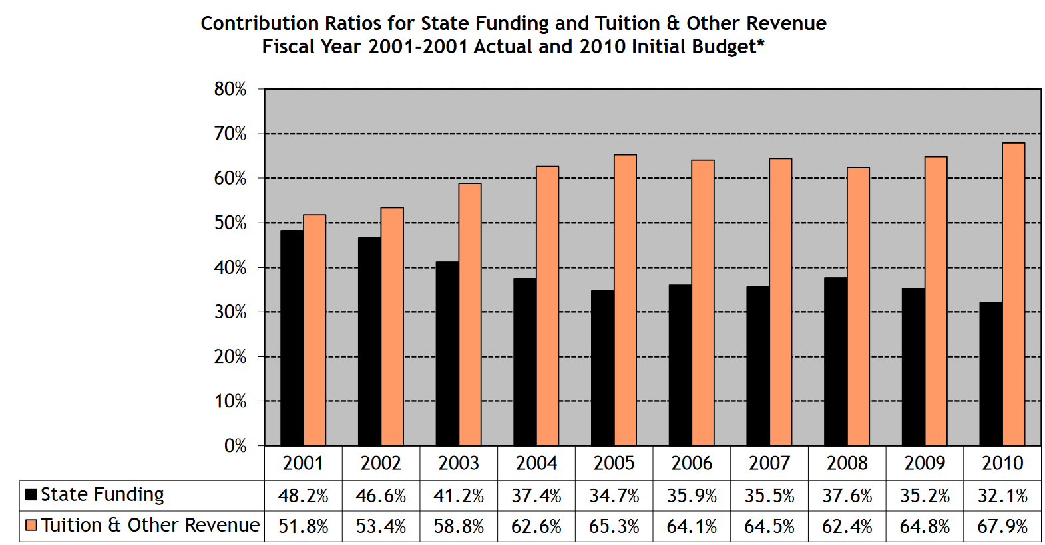

Slide 6
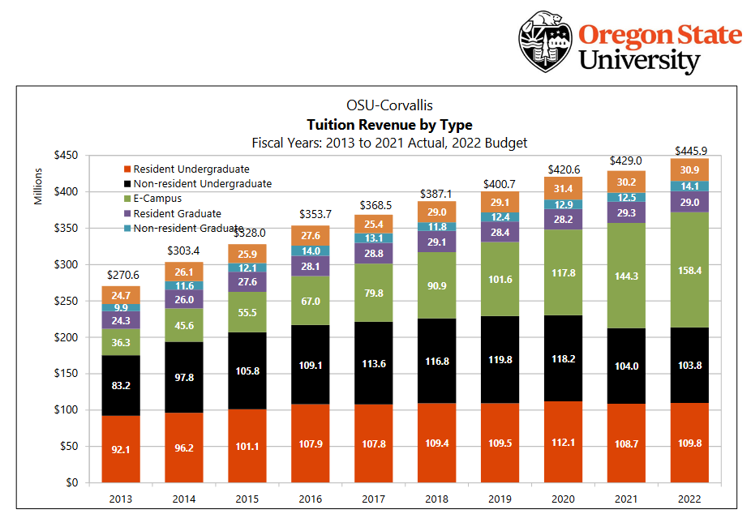

Slide 7
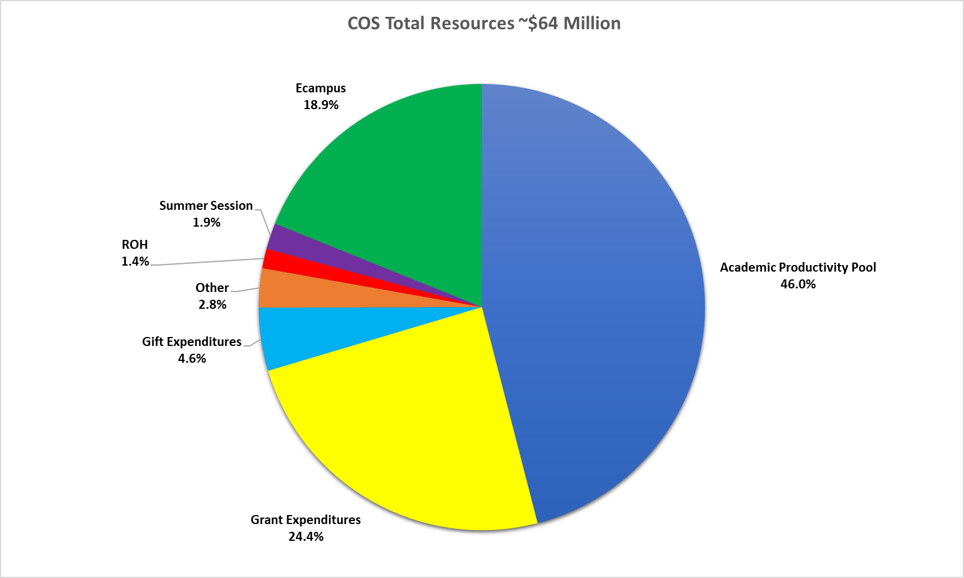

Slide 8
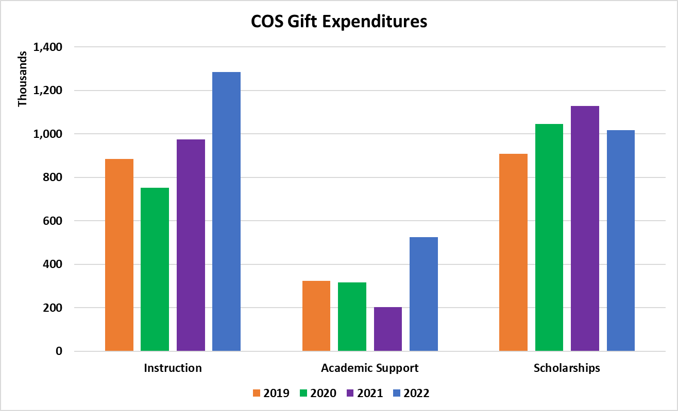

Slide 9
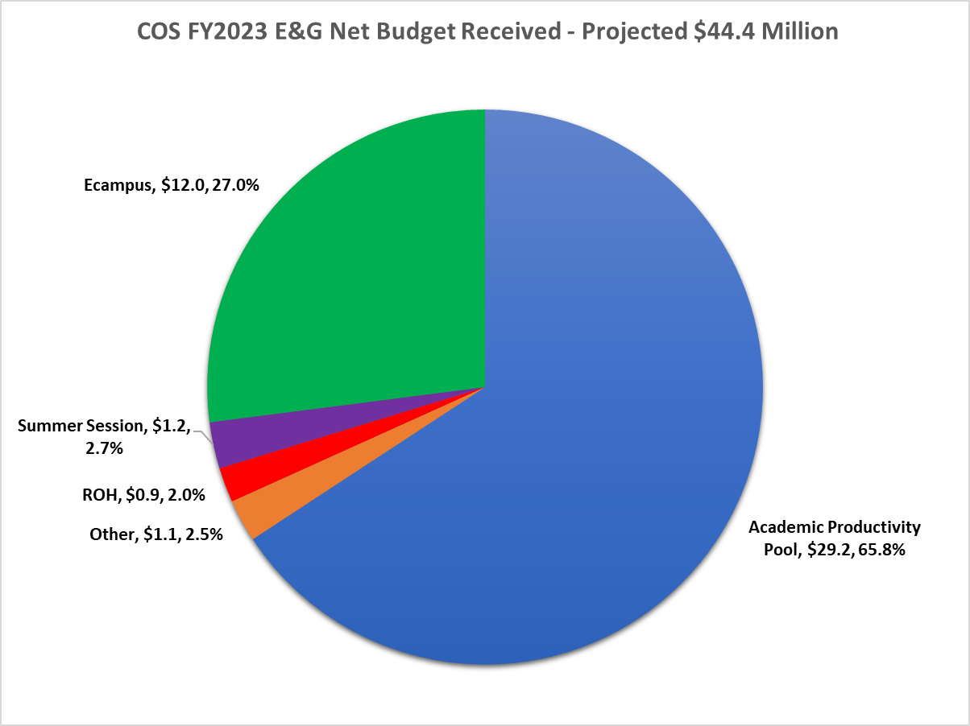

Slide 10
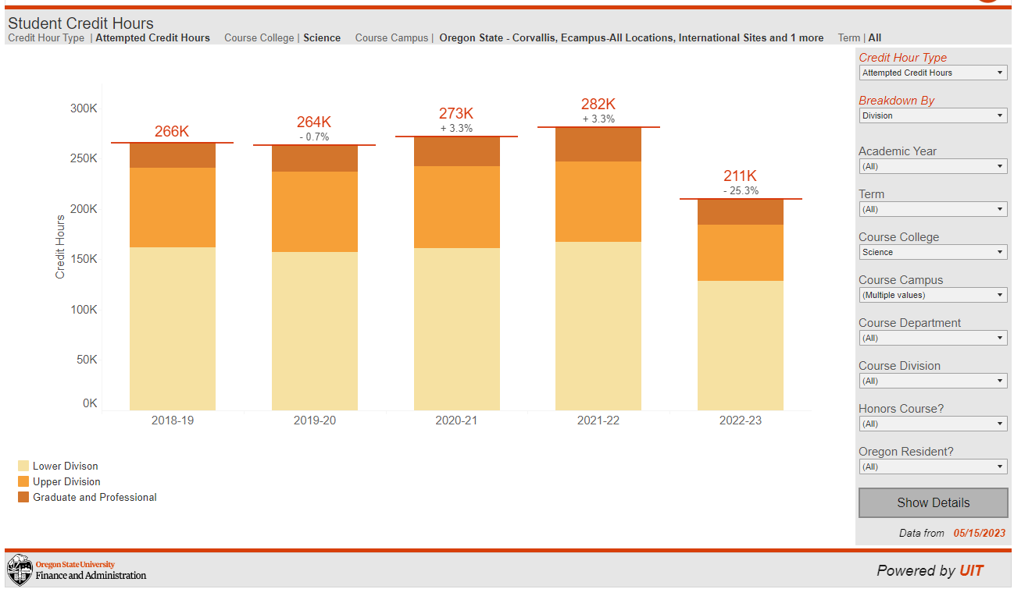

Slide 11
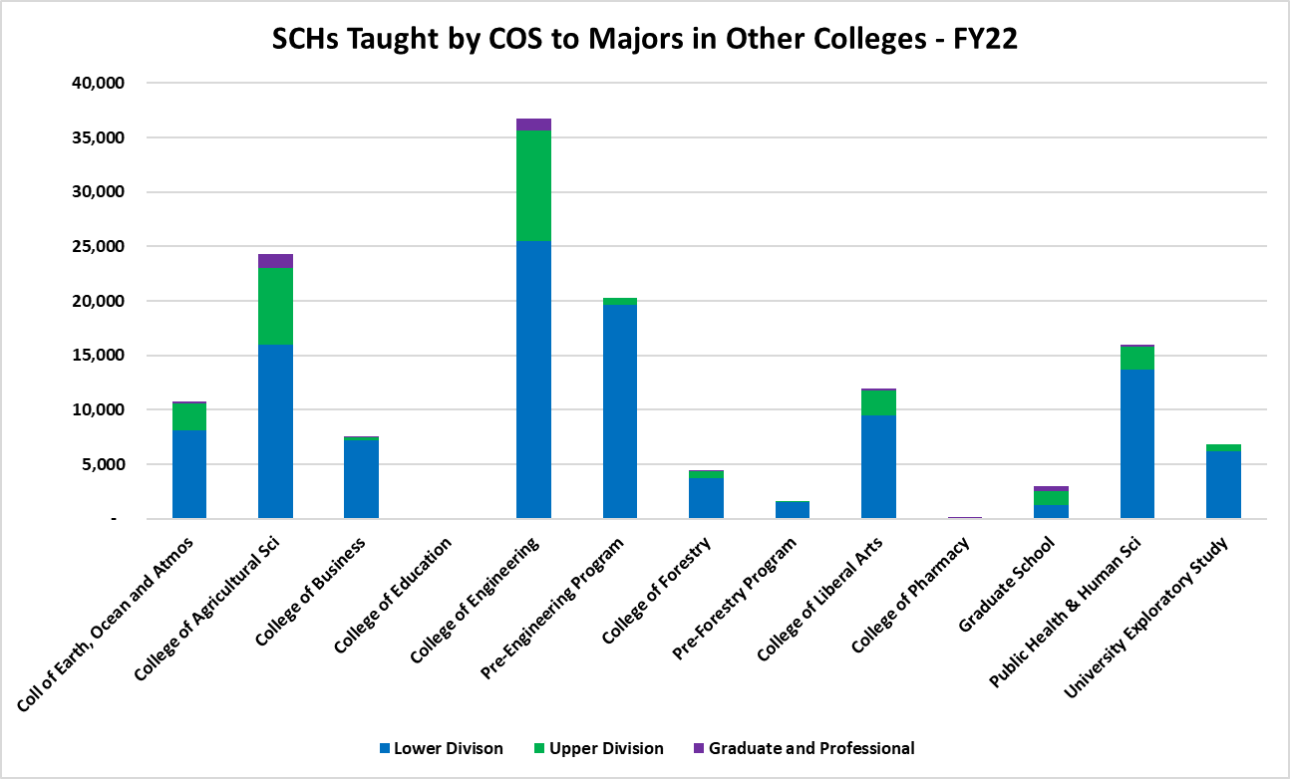

Slide 12
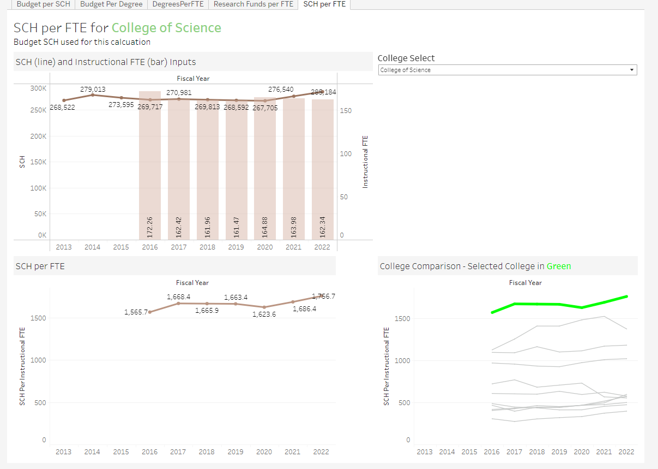

Slide 13
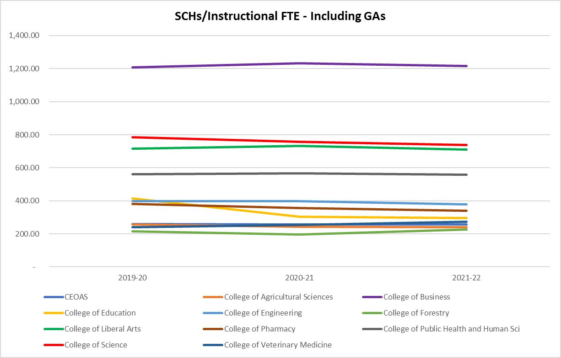

Slide 14
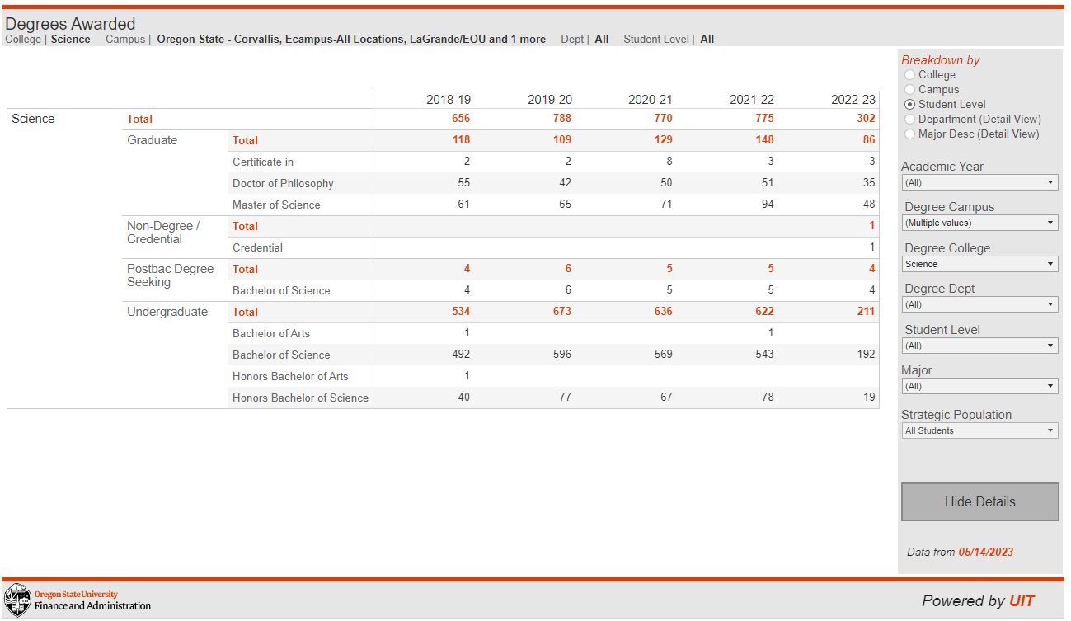

Slide 15
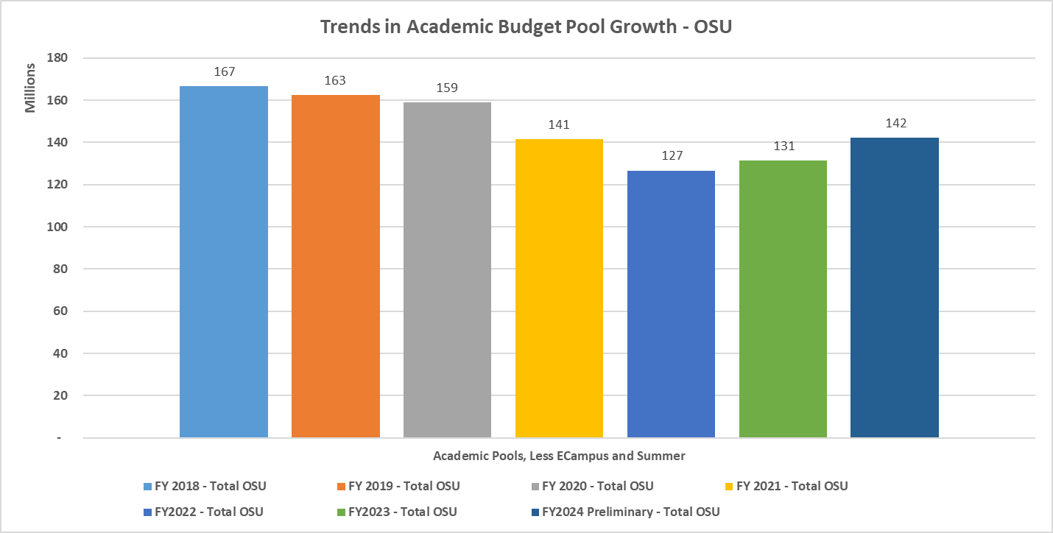

Slide 16
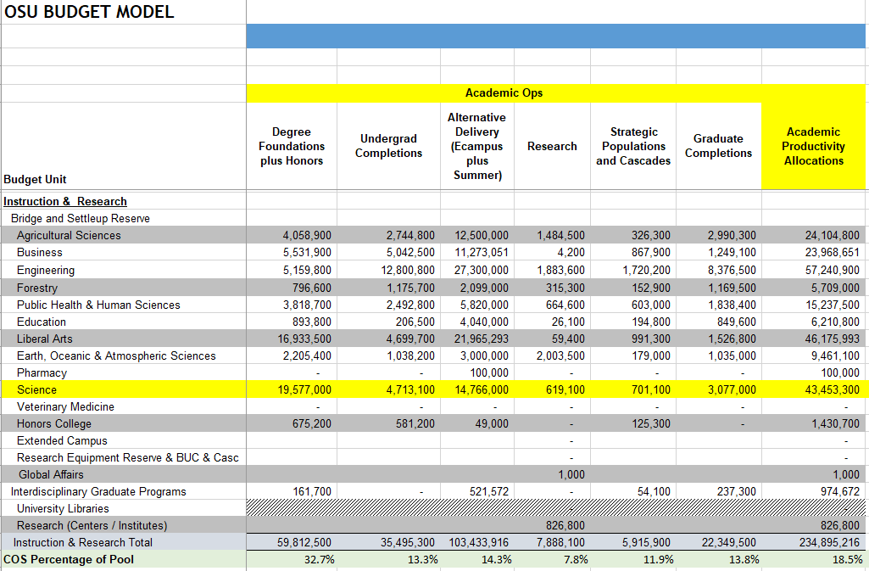
https://fa.oregonstate.edu/budget/budget-model

Slide 17
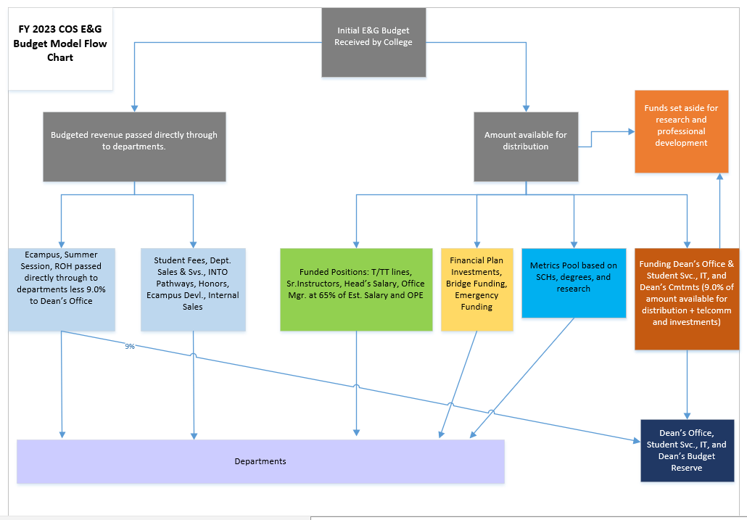

Slide 19
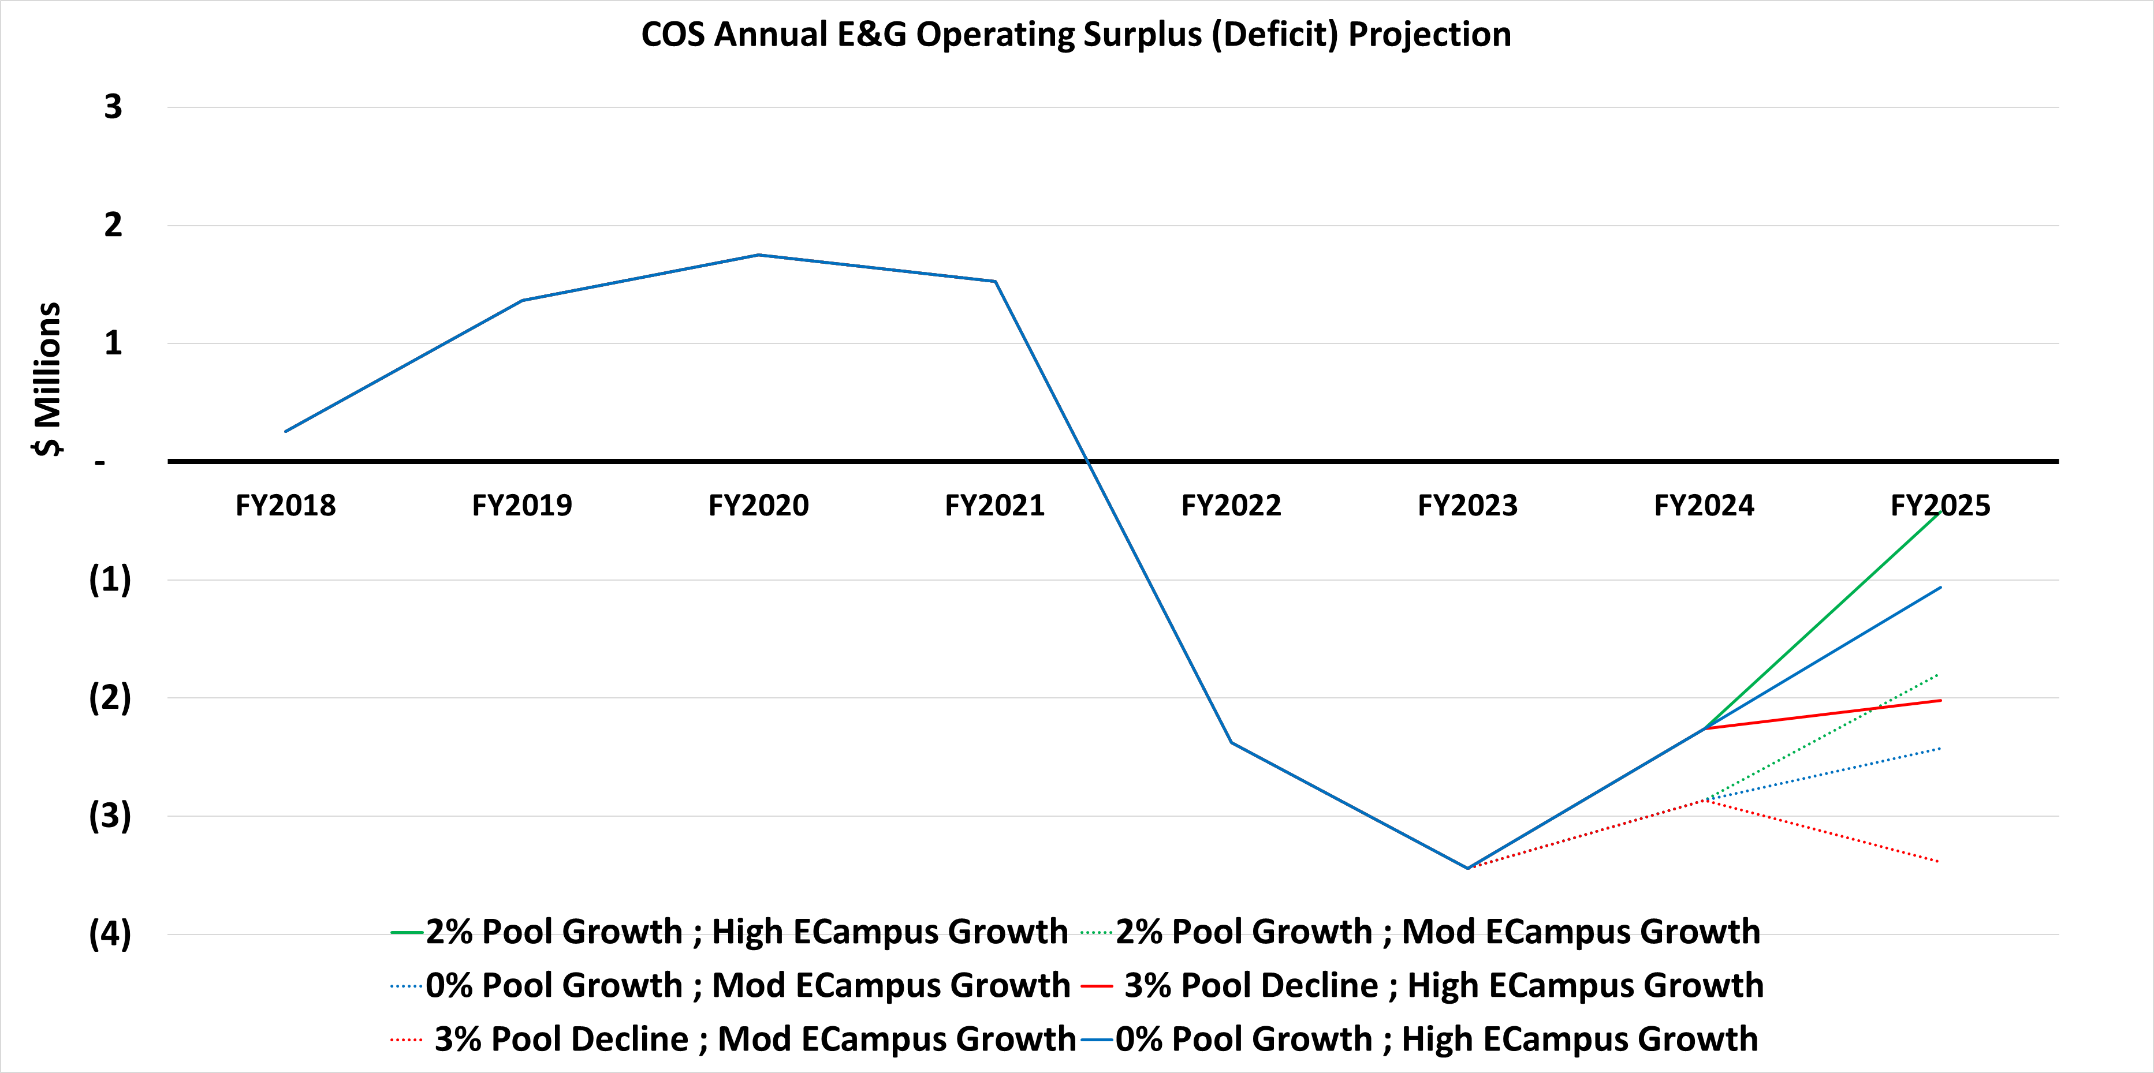

Slide 20
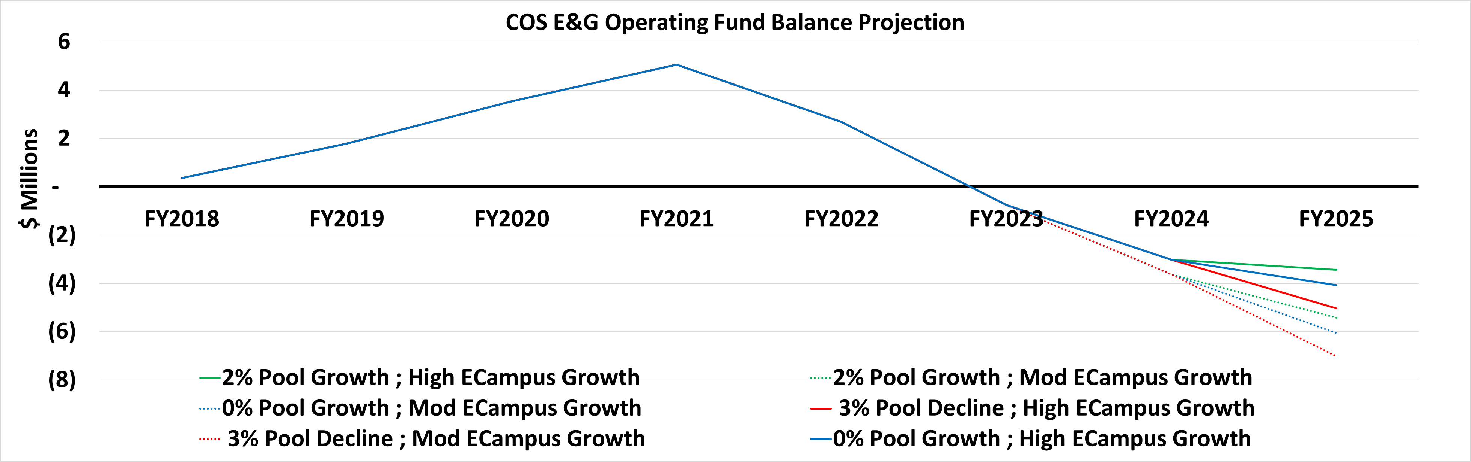

Slide 21
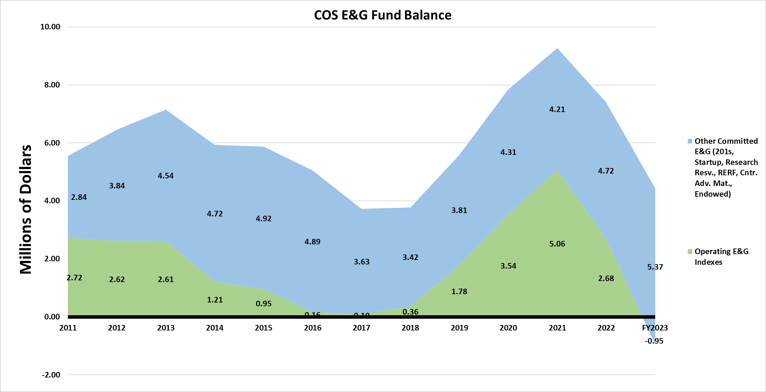

Slide 23
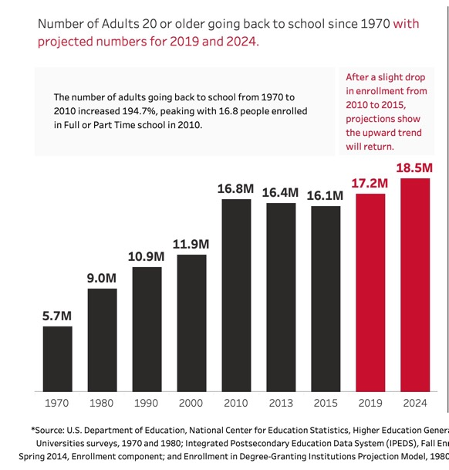
SRBM Proposed Revisions—February 2023
The Ecampus incentive question is critical
  Traditional students are declining; growth opportunities largely in Ecampus and at Cascades
  The SRBM budgets to the colleges. It is critical that college-level conversations define strategy.
Notes:
For discussion as needed

Slide 24
SRBM Proposed Revisions—February 2023
The Ecampus incentive question is critical
  Corvallis projections reflect this—reach flat enrollment in about FY26
  SRBM budgets to the colleges—it is critical that college-level conversations define strategy for allocations from colleges to units.
  Faculty development $, advising $, program coordinators $, course redevelopment $ continue
  Ecampus is a structural part of the university and nearly every college
Notes:
For discussion as needed

Slide 25
Questions

